Slide 1





BUSINESS CASE STUDY
DropItLikeItsHot Partnership Evaluation
CPC → CPO Switch (Aug 2023)
Impact Analysis for The X firm
Presented by:.
EMRE ÖZYÜREK
X x EMRE OZYREK

Slide 2

Executive Summary
Goals and Objectives
KPI Framework
Weekly KPI Trends - CR
Weekly KPI Trends - RPC
Weekly KPI Trends -Revenue growth
AGENDA
Weekly KPI Trends - Clickouts
Weekly KPI Trends -OOP Growth
Category Performance
Underperforming Segments
Category Benchmarks
Platform Impact
FINAL CONCLUSION
Next Steps

Slide 3




EXECUTIVE SUMMARY
KPI | Pre | Post | Change
Total Revenue (Partner Shops) | €294k | €1.38M | 370%
Conversion Rate (CR) | 0.2–0.3% | 11–13% | ×40–80
RPC | € 0.10 | € 0.12 | +20% blended
Clickouts | 2.79M | 11.25M | 303%
Inventory (OOP) | 432k | 2.56M | 494%
The DropItLikeItsHot CPO switch was highly beneficial for X firm, generating +€1.08M incremental partner revenue with no cannibalization on other shops.
All Pre vs Post differences statistically significant (t-test, p < 0.001).

Slide 4



GOALS AND OBJECTIVES
OBJECTIVES
TIMELINE
Evaluate whether switching Shop 10 & 463 from CPC → CPO was beneficial to X.
Pre-CPO: Jan 2023 – Aug 13, 2023
TRANSITION WEEK: AUG 14–20 (18), 2023
Post-CPO: Aug 21, 2023 – Aug 2024
Transition Week (Excluded from KPIs): 14–20 Aug 2023
Inventory upload and CPO activation overlap; unstable behavior.

Slide 5
KPI FRAMEWORK
1. Conversion Rate (CR)
CR = Conversions / Clickouts
2. Revenue per Click (RPC)
RPC = Revenue / Clickouts
3. Inventory Commitment (OOP Growth)
OOP% = (OOP_post – OOP_pre) / OOP_pre × 100
4. Revenue Growth
Rev% = (Rev_post – Rev_pre) / Rev_pre × 100
5. Clickout Impact
Clickouts% = (CO_post – CO_pre) / CO_pre × 100
5

Slide 6

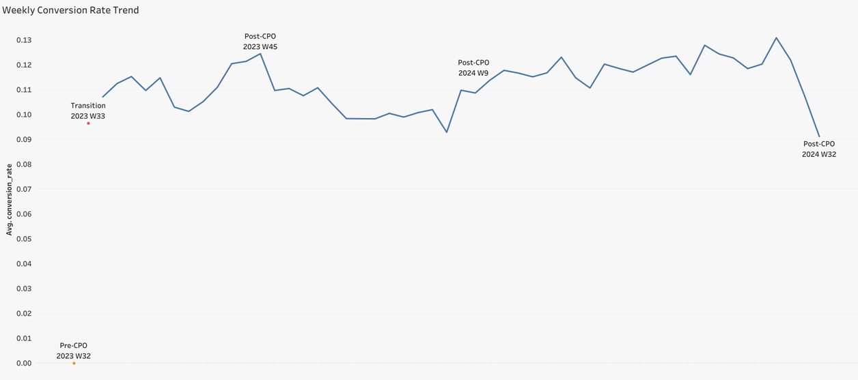
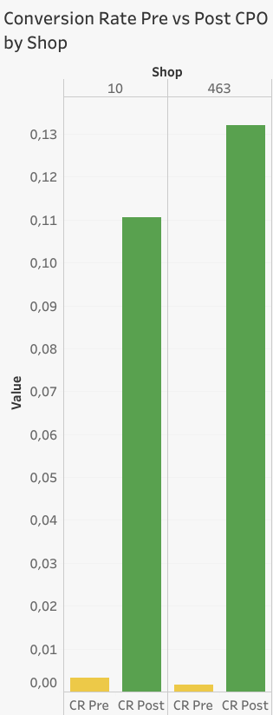

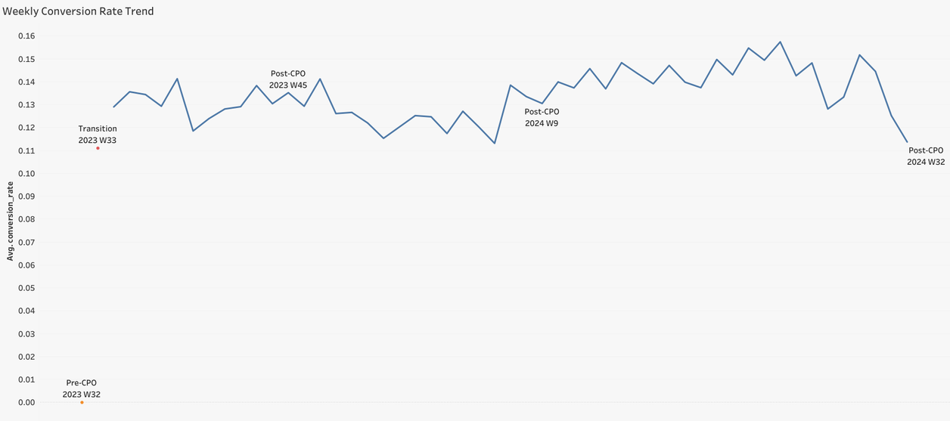
WEEKLY KPI TRENDS
(SHOP 10 & 463)
→ CONVERSION
RATE (CR)
After switching Shop 10: ×34 improvement
After switching Shop 463:
×83 improvement
Shop 10
Traffic is converting well
Users are not just clicking; they actually buy the products
Strong signal the partnership works in practice, not just on paper
Shop 463

Slide 7
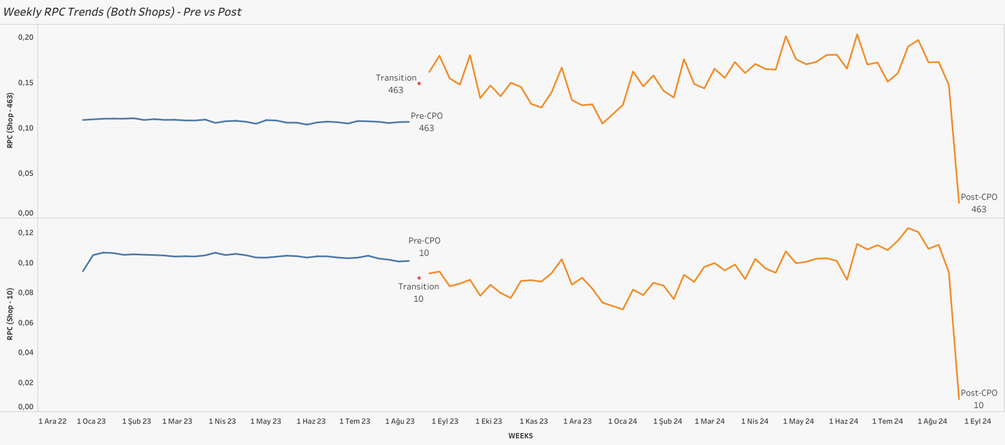
WEEKLY KPI TRENDS
(SHOP 10 & 463)
→ REVENUE PER CLICK (RPC)
Shop 10: Slight RPC dilution due to broader inventory.
Shop 463: Due to increase, their traffic became more valuable per user.
Shop 10 drives volume; Shop 463 drives value. Both contribute differently but positively to idealo.
Post | Diff. | Shops | Pre
€0.092 | –10% | Shop 10 | €0.103
€0.155 | +45% | Shop 463 | €0.107

Slide 8
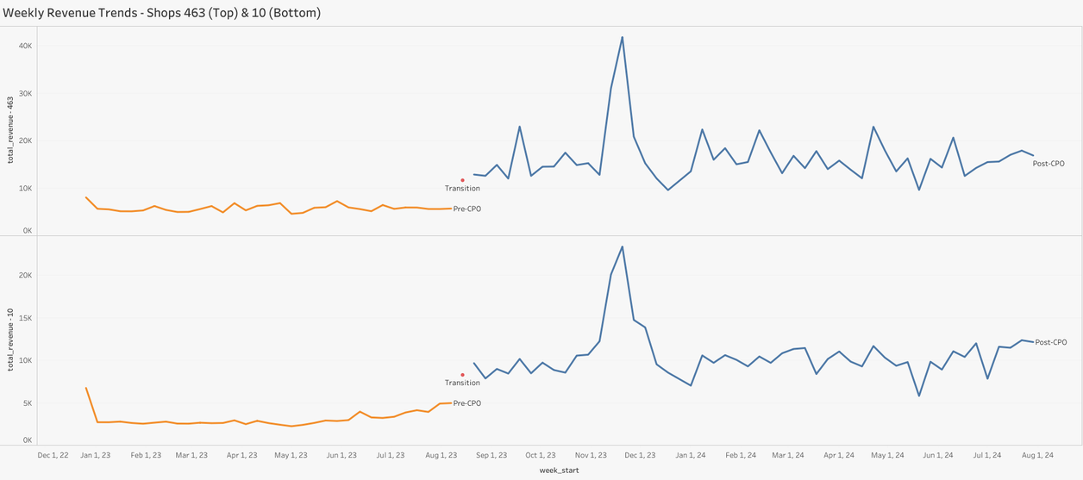

WEEKLY KPI TRENDS
(SHOP 10 & 463)
→ REVENUE GROWTH
Shop 10;
Pre: €3.13k/week
Post: €10.37k/week
Shop 463:
Pre: €5.8k/week
Post: €16.13k/week
Seasonal pattern appears after CPO:
Q4: peak (Black Friday & Christmas)
Jan–Feb: normalization
Easter/Summer dips
Stable week-over-week uplift, not a one-time boost.
8

Slide 9
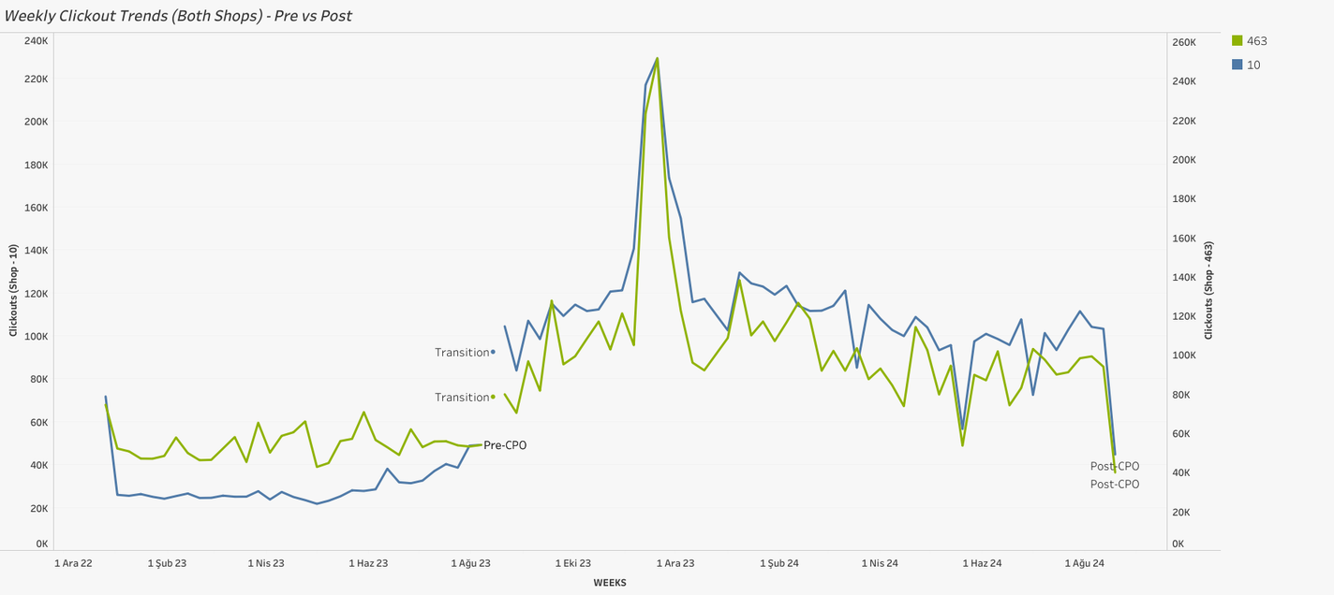
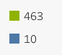
WEEKLY KPI TRENDS
(SHOP 10 & 463)
→ CLICKOUTS
Shop 10 :
Pre: ~30.4k/week
Post: ~112.3k/week (+482%)
Shop 463:
Pre: ~54.2k/week
Post: ~104.1k/week
No cannibalization of other shops detected; platform traffic also grows
Shop 10 experiences massive visibility gain because OOP grew +874%
Shop 463 also grows strongly but more controlled (OOP +189%).
9

Slide 10

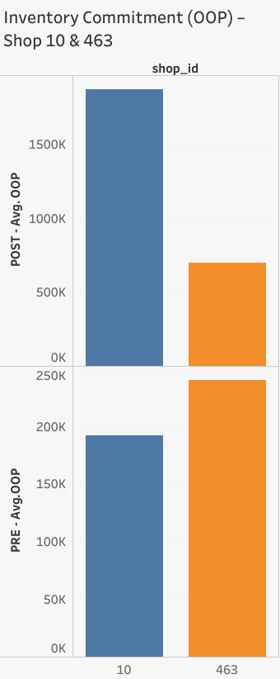
WEEKLY KPI TRENDS
→ INVENTORY COMMITMENT (OOP GROWTH)
Growth Perc. | Shop ID/Partner | AVG OOP -Pre | AVG OOP -Post
(+875%) | 10 | 191,723 | 1,868,334
(+189%) | 463 | 240,019 | 694,958
+494% combined OOP growth | DroptLikeItsHot | 431,742 | 2,563,292
Partner fulfilled (and exceeded) inventory commitmentt.
(Switch to CPO; upload more products)
The pattern we observe:
OOP ↑ → clickouts ↑ → conversions ↑ → revenue ↑
But increased inventory alters RPC!
Shop 10 shows this effect clearly,
Shop 463 less affected because their catalog is higher value.

Slide 11
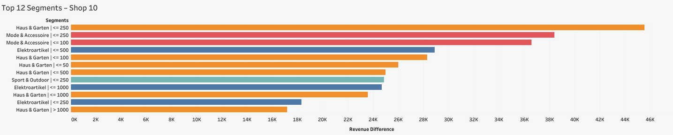
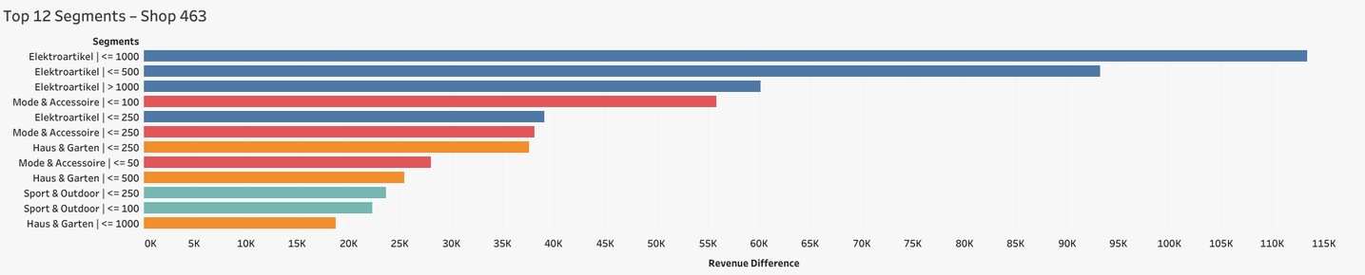
CATEGORY PERFORMANCE
Top 12 Revenue Uplift Segments For The Shops
KEY INSIGHTS (SHOP 10):
Haus & Garten and Mode & Accessoire dominate uplift.
Strongest growth in ≤ €250–500 price buckets.
KEY INSIGHTS (SHOP 463):
Elektroartikel leads revenue gains across mid/high price buckets.
11

Slide 12




UNDERPERFORMING SEGMENTS
NEGATIVE REVENUE SEGMENTS (SHOP 463)
AUTO & MOTORRAD ≤ €10
ELEKTROARTIKEL ≤ €10
ELEKTROARTIKEL ≤ €20
Revenue_Diff | Pct. Change | Revenue Pre | Revenue_Post
-2.22 | -81.9% | 2.71 | 0.49
-127.53 | -36.5% | 349.33 | 221.8
-179.18 | -13% | 1382.95 | 1203.77
Insight:
Underperformance isolated to
< €20 buckets (low RPC, low intent).
Restrict uploads or optimize.

Slide 13
CATEGORY BENCHMARKS
Category | Typical CR | Typical RPC (€)
Elektroartikel | 10–14% | 0.07–0.17
Haus & Garten | 11–13% | 0.08–0.16
Mode & Accessoire | 13–15% | 0.09–0.12
Sport & Outdoor | 12–13% | 0.09–0.16
Auto & Motorrad | 5–7% | 0.05–0.15
NO MAJOR CATEGORY UNDERPERFORMS BENCHMARKS — CONFIRMING THE CPO MODEL SCALES EFFICIENTLY ACROSS ALL VERTICALS.
The uplift is real, not seasonal.
The uplift is quality-driven, not from low-value clicks.
The uplift is sustainable, because it's across all categories.
13

Slide 14
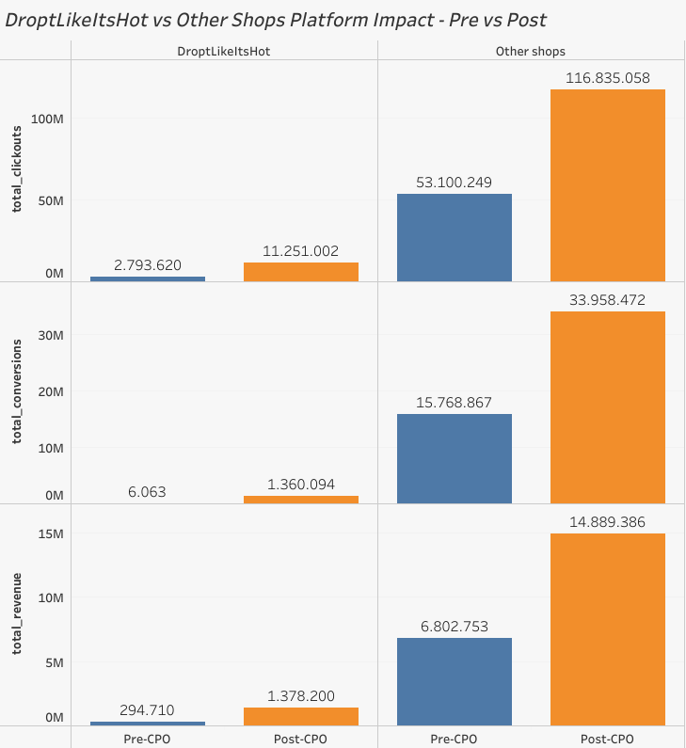
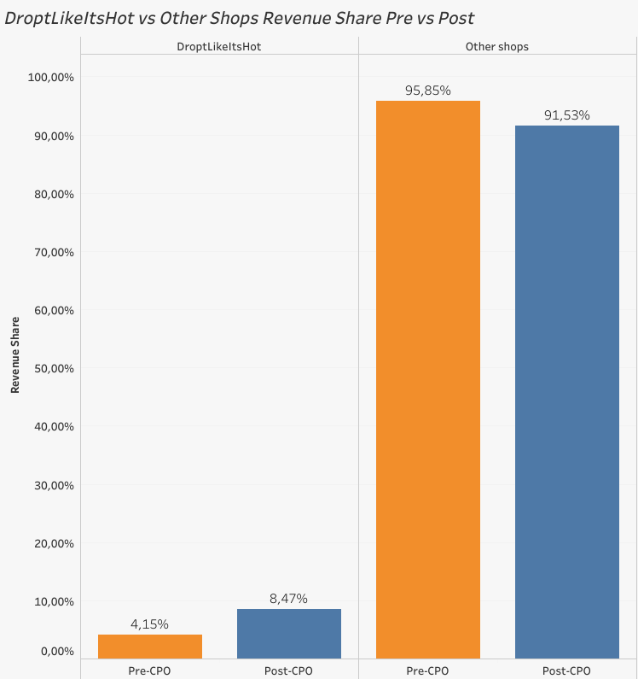
DROPTLIKEITSHOT VS OTHER SHOPS PLATFORM IMPACT (PRE VS POST CPO)
01
DROPT’S TRAFFIC EXPLODES AFTER CPO
Clickouts grow from 2.8M → 11.3M (+303%), outpacing platform avg (+129%).
02
CONVERSIONS SCALE
MASSIVELY
6k → 1.36M conversions.
(CPC logs are only predicted)
03
REVENUE GROWS 4.7×
€294k → €1.38M.
04
OTHER SHOPS KEEP GROWING NORMALLY
Platform revenue still grows +119% without decline (no cannibalization effect)
05
DROPT’S PLATFORM REVENUE SHARE NEARLY DOUBLES
4.1% → 8.5%

Slide 15

FINAL CONCLUSION
WAS THIS DEAL BENEFICIAL TO X? | EVIDENCE? | GAIN?
YES. Decisively | Revenue: +338–422% CR: 0.2–0.3% → 11–13% RPC: stable or +45% Clickouts: +200–480% Inventory: +494% partner-level OOP Platform Revenue: +129% Partner revenue share: 4.1% → 8.5% No cannibalization | Net gain: +€1.08M
15

Slide 16
NEXT STEPS
Build a weekly dashboard (CR, RPC, OOP, Share)
Maintain CPO for both Shop 10 and 463
Optimize uploads:
Boost: ≤ €500 high-performing buckets
Limit: < €20 low-margin buckets
Consider CPO rollout to 2–3 similar partners
Monitor Q4 2024–Q1 2025 seasonality to validate uplift persistence

Slide 17




THANK YOU!
EMAIL
emreozyurekofficial@gmail.com
CALL
155-10-619-384

